Slide 1

COFFEE SHOP SALES DASHBOARD
DATA ANALYST PORTFOLIO PROJECT
Transforming raw Excel data into actionable retail intelligence.
Prepared By
PLATFORM
Munshidha Nashrin Vk
Advanced Excel Dashboards

Slide 2
Agenda
From raw transaction logs to interactive insights.
1. Objectives
2. Dataset Overview
3. Data Cleaning
4. Calculated Columns
5. Dashboard Layout
6. Insights & Strategy

Slide 3






Project Objectives
CORE BUSINESS QUESTIONS
Store Performance
Peak Operations
Product Mix
Identify top revenue-generating branch locations.
Pinpoint high-demand hours to optimize barista staffing.
Evaluate profitability and cross-sell opportunities.

Slide 4
Dataset Overview
Column Name | Data Type | Description
transaction_id | Numeric | Unique identifier per order.
transaction_date | Date/Time | Timestamp of the purchase.
store_location | Text | Manhattan, Astoria, etc.
product_category | Text | Coffee, Tea, Bakery, Packaged.
unit_price | Decimal | Price per individual item.
transaction_qty | Numeric | Number of items in cart.
149116
ROWS
18
COLUMNS
CATALOG
9 Distinct Categories

Slide 5
Data Cleaning Methods
Transforming raw records to analysis-ready datasets.
1
2
3
Hygiene & Standardization
Formatting & Outliers
Model Loading
Converted date/time types.
Optimized for Pivot Tables.
Removed duplicate rows.
Filtered pricing anomalies.
Loaded clean table to Excel.
Handled null values.
Validated transaction quantities.
Verified 100% error-free.
Standardized text casing.

Slide 6
Store Dominance Hell's Kitchen is the top performer, generating 34% of total branch sales, driven by high foot traffic and demand for premium beverages
Core Transactions Coffee and tea account for over 65% of transaction volume. Frequent single-item coffee orders lower the average transaction value.
Peak Operational Hours The 7:00-10:00 AM rush accounts for 55% of daily transactions and often causes line congestion and bottlenecks.
Revenue Volatility Growth is steady with seasonal spikes, but revenue softens in slower mid-season months.
Solutions
Operational Replication Lift underperforming Astoria shifts by copying the inventory and staffing models used at Hell's Kitchen.
Strategic Product Bundling Offer discount bundles that pair core coffee with high-margin bakery items to raise average transaction value.
Queue Optimization Reduce morning congestion with mobile ordering and pre-packed grab-and-go bakery displays.
Targeted Marketing Campaigns Smooth mid-season dips with seasonal promos and loyalty punch-cards in slower
Business insights

Slide 7
Calculated Columns
Creating analytical dimensions for deeper slicing.
Generated Column | Purpose / Dimension | Logic Structure
Total Sales | Calculate revenue per order row. | =[@transaction_qty] * [@unit_price]
Time Period | Group hours into operational shifts. | =IF([@hour]<11, "Morning", "Afternoon"...)
Price Category | Segment products by value tier. | =IF([@unit_price]<3, "Low", "High")
Month Name | Enable seasonal trend analysis. | =TEXT([@transaction_date], "mmmm")
Year Name | Enable seasonal trend analysis | =TEXT([@transaction date,] “yyyyy”)
Quantity Category | Categorized transactions based on quantity sold | =IF([@transaction_qty]<=2,"Low",IF([@transaction_qty]<=5,"Medium","High"))
Average item value | Calculated the average value per item | =[@unit_price]

Slide 8




Chart Specifications
Total by Store
Sales by Month
Type: Column Bar
Purpose: Compare branch revenue.
Type: Line Chart
Purpose: Track monthly trajectory trends.
Category Volume
Average Item Value
Type: Doughnut
Purpose: Evaluate share of volume.
Type: Horizontal Bar
Purpose: Evaluate category pricing strength.

Slide 9
Dashboard Architecture & Layout
NUMBER | CHART TITLE | CHART TYPE
1 | STORE LOCATION | BAR
2 | PRODUCT CATEGORY | LINE
3 | PRODUCT TYPE | CLUSTERD COLUMN
4 | AVERAGE ITEM VALUE | LINE
5 | STORE LOCATION | CLUSTERD COLUMN
6 | QUANTITY CATEGORY | BAR
7 | TRANSACTION BY PRODUCT CATEGORY | DONUT
8 | SALES BY MONTH | LINE
9 | PRODUCT DETAIL | BAR
10 | SALES CATEGORY | CLUSTERD COLUMN

Slide 10
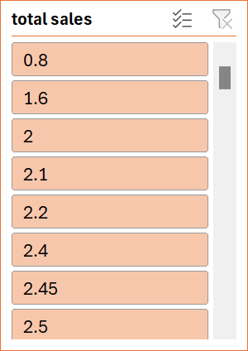
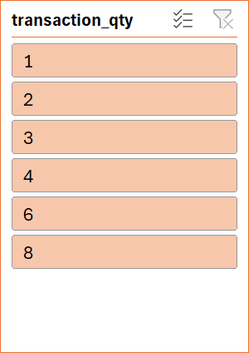
1. Coffee shop sales dashboard
Dashboard View 1
TOTAL SALES
TOTAL TRANSACTIONS
TOTAL QTY SOLD
AVG TRANSACTION VALUE
698812.33
149116
214470
3.382219413

Slide 11
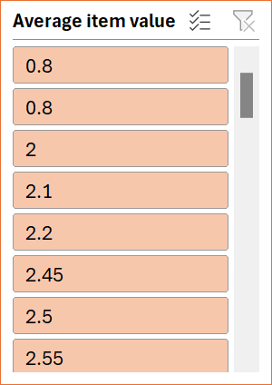
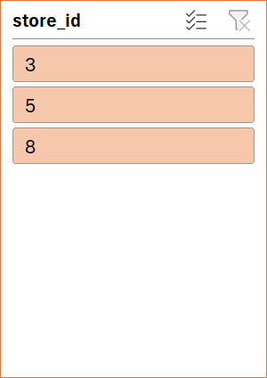
2. Coffee shop sales dashboard
Dashboard View 2
AVERAGE UNIT PRICE
UNIQUE STORES
TOTAL SALES BY STORE
3.3822
149116
698812.33

Slide 12
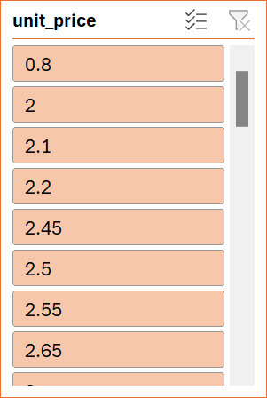

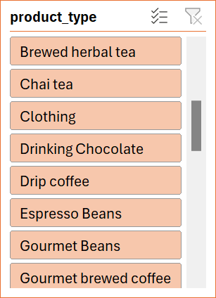
3. Coffee shop sales dashboard
Dashboard View 3
MAXIMUM UNIT PRICE
TOP PRODUCT BY SALES
MAXIMUM UNIQUE PRODUCTS
45
177375.25
24
Monthly Growth
Morning Rush
Up
55%
Steady upward momentum with seasonal spikes.
Peak volume between 7:00 AM and 10:00 AM.

Slide 13
Key Insights & Recommendations
1
2
3
Hell's Kitchen Dominates
Coffee & Tea Core
Morning Velocity
Coffee and Tea account for over 65% of volume. Single-item coffee transactions lower average value.
Mornings define revenue velocity (55%), but suffer from line congestion bottlenecks.
Hell's Kitchen leads total sales by 34%, driven by high foot traffic and premium beverage demand.
STRATEGY
STRATEGY
STRATEGY
Replicate Hell's Kitchen staffing models across Astoria.
Bundle high-margin bakery items with core coffees.
Deploy mobile ordering and pre-pack grab-and-go displays.

Slide 14

Project Summary
Data Preparation
Cleaned dataset, handled data types, and prepared for analysis.
Calculated Columns
Created fields like Time Period, Month Name, and Total Sales.
Dashboard Development
Created KPIs, PivotTables, and Slicers for interactivity.
Business Value
Identified patterns and provided actionable retail solutions.

Slide 15
Conclusion
Overall, this project demonstrated how advanced Excel can be used to transform raw coffee shop transaction data into an interactive and meaningful analytical dashboard. The analysis provided deep insights into store performance, product mix profitability, and temporal rush patterns. Through this project, actionable retail strategies—such as optimized staffing and product bundling—were developed to directly address identified operational bottlenecks.

Slide 16



Thank You

